Slide 1


Promise with : $q

Slide 2
Promises
What is a promise?
The Promise object is used for asynchronous computations. A Promise represents a value which may be available now, or in the future, or never.
A Promise is in one of these states:
pending: initial state, not fulfilled or rejected.
fulfilled: meaning that the operation completed successfully.
rejected: meaning that the operation failed.
Promises are good for handling asynchronous operations:
Wait for a large file to load
Wait for a server to respond
Wait for a user to confirm or abort an operation
…

Slide 3
Promises
The Deferred API
A new instance of deferred is constructed by calling $q.defer().
The purpose of the deferred object is to expose the associated Promise instance as well as APIs that can be used for signaling the successful or unsuccessful completion, as well as the status of the task.
Methods
resolve(value) – resolves the derived promise with the value. If the value is a rejection constructed via $q.reject, the promise will be rejected instead.
reject(reason) – rejects the derived promise with the reason. This is equivalent to resolving it with a rejection constructed via $q.reject.
notify(value) - provides updates on the status of the promise's execution. This may be called multiple times before the promise is either resolved or rejected.
Properties
promise – {Promise} – promise object associated with this deferred.

Slide 4
Promises
The Promise API
A new promise instance is created when a deferred instance is created and can be retrieved by calling deferred.promise.
The purpose of the promise object is to allow for interested parties to get access to the result of the deferred task when it completes.
Methods
then(successCallback, [errorCallback], [notifyCallback]) – regardless of when the promise was or will be resolved or rejected, then calls one of the success or error callbacks asynchronously as soon as the result is available
catch(errorCallback)
finally(callback, notifyCallback) – allows you to observe either the fulfillment or rejection of a promise, but to do so without modifying the final value.

Slide 5
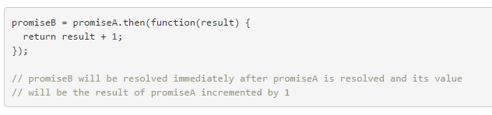
Promises
Chaining promises
Because calling the then method of a promise returns a new derived promise, it is easily possible to create a chain of promises:

Slide 6
Promises
Angular $q
A service that helps you run functions asynchronously
defer();
Creates a Deferred object which represents a task which will finish in the future
all(promises);
Combines multiple promises into a single promise that is resolved when all of the input promises are resolved.
race(promises);
Returns a promise that resolves or rejects as soon as one of those promises resolves or rejects, with the value or reason from that promise.

Slide 7
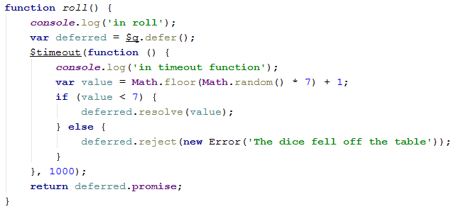
Promises
creating a promise

Slide 8
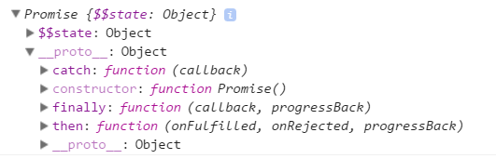

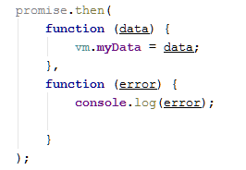
Promises
Available mehods =>
Using a promise :
A little better !
see next slide for top of the top !

Slide 9

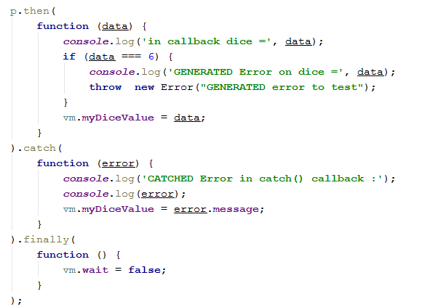
Promises
SOLUTION for catching ALL error(s) even those happening inside the callbacks

